Slide 1
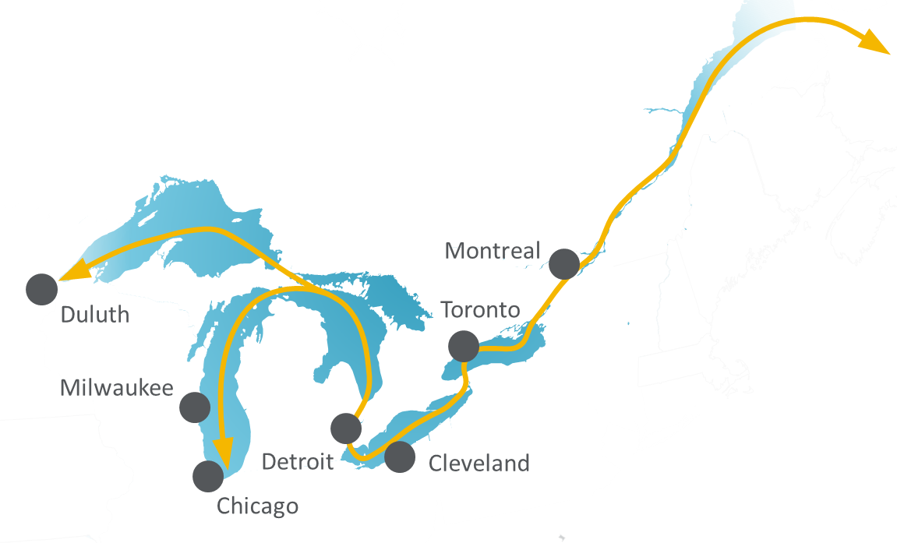







The Great Lakes
St. Lawrence Maritime System
Backbone of a nearly $8 Trillion Regional Economy
100
10
2
1
million
people
states &
provinces
countries
region and
maritime system
The Great Lakes St. Lawrence region includes the US states of Illinois, Indiana, Michigan, Minnesota, New York, Ohio, Pennsylvania, and Wisconsin, and Canadian provinces of Ontario and Quebec. If these were a single country, they would have the third largest economy in the world.
This economy is supported by the world’s largest inland waterway: the Great Lakes and St. Lawrence River.
This system provides a direct shipping connection between North America’s economic core and global markets.
100+ ports handle 400+ million tons each year:
Major International Cargo
Major Domestic Cargo
containers
steel
grain
machinery
iron ore
coal
aggregate
cement
The system handles essential cargo and is trusted by some of the world’s biggest shippers, including ADM, Cleveland-Cliffs, Cargill, Rio Tinto, and Siemens. Some international carriers serving the system include Fednav, Spliethoff, Wagenborg, and BBC.
Great Lakes St. Lawrence ports connect to the rest of North America:
6
major railroads
40
major highways
150
million people within 8 hours
Our maritime system is a green shipping option for bulk and oversize cargo:
=
with
High
Fuel Efficiency
Small
Carbon Footprint
move 1 ton of cargo
1 litre
358 km
of fuel
Great Lakes
St. Lawrence system ports are ready to meet your needs.
Cargoes:
Value-Added Services:
Customs Clearance
Foreign Trade Zones
Heavy Lift
Storage
Warehousing
dry and liquid bulk
containers
gsgp.org
break-bulk

